Slide 1
VIRTUAL MEMORY
By: Navjot Kaur

Slide 2
VIRTUAL MEMORY
Virtual memory is a feature of an operating system that allows a computer to compensate for shortages of physical memory by temporarily transferring pages of data from random access memory (RAM) to disk storage.
It is a technique that allows execution of processes that are not completely in memory.
One of the major advantage of this scheme is that programs can be larger than the physical memory available.

Slide 3
VIRTUAL MEMORY
Reason to move pages of data from RAM to disk storage - Because OS was running out of RAM.
Solution: The operating system will need to move other pages to hard disk so it has space to bring back the pages it needs from temporary disk storage.
This process is known as paging or swapping and the temporary storage space on the hard disk is called a page file or a swap file.

Slide 4
VIRTUAL MEMORY
Separation of user logical memory from physical memory.
Program would no longer be constrained by the amount of physical memory that is available.
Because each program takes less space, more program could be run at the same time.
Less I/O would be needed to load or swap each user program into memory, Virtual memory can be implemented via:
  Demand paging
  Demand segmentation

Slide 5
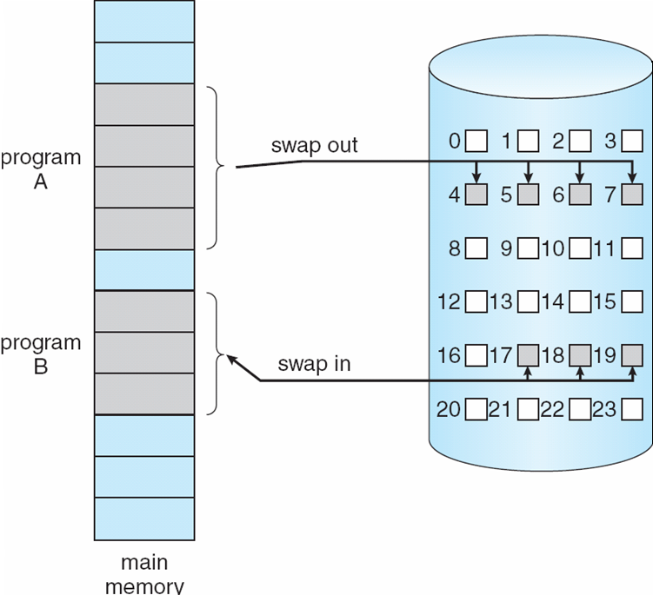
Transfer of a Paged Memory to Contiguous Disk Space

Slide 6
Demand Paging
Bring a page into memory only when it is needed
  Less I/O needed
  Less memory needed
  Faster response
  More users
Page is needed ⇒ reference to it
  not-in-memory ⇒ bring to memory
Lazy swapper – never swaps a page into memory unless page will be needed
  Swapper that deals with pages is a pager

Slide 7
Valid-Invalid Bit
With each page table entry a valid–invalid bit is associated
(v ⇒ in-memory, i ⇒ not-in-memory)
Initially valid–invalid bit is set to i on all entries
Example of a page table snapshot:
During address translation, if valid–invalid bit in page table entry
is I ⇒ page fault
Frame #
valid-invalid bit
v
v
v
v
i
….
i
i
page table

Slide 8
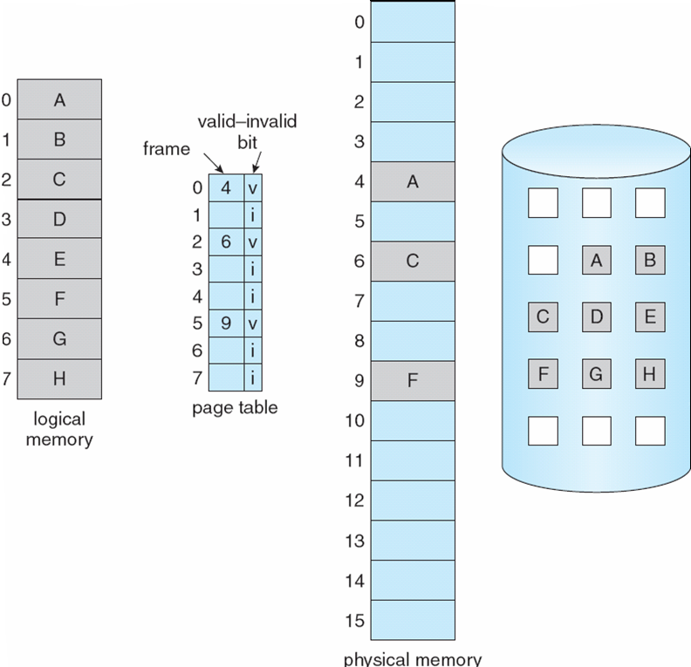
Page Table When Some Pages Are Not in Main Memory

Slide 9
Page Fault
If the required page is not available in Physical Memory: Page Fault
If there is a reference to a page, first reference to that page (if page is not available in physical memory) will trap to operating system: page fault
Get empty frame
Swap page into frame
Reset tables
Set validation bit = v
Restart the instruction that caused the page fault

Slide 10

Steps in Handling a Page Fault

Slide 11
What happens if there is no free frame?
Page replacement – find a page in memory and swap it out
  Replacement algorithm selects the victim page
  want an algorithm which will result in minimum number of page faults

Slide 12
Basic Page Replacement
Find the location of the desired page on disk
Find a free frame:
- If there is a free frame, then use it
- If there are no free frames, use a page replacement algorithm to select a victim frame
Bring the desired page into the (newly) freed frame, and update the page and frame tables
Restart the interrupted instruction of the process

Slide 13

Page Replacement
Use modify (dirty) bit to reduce overhead of page transfers
  If victim page is unmodified, then no need to write it back to disk

Slide 14
Page Replacement Algorithms
Want lowest page-fault rate
  Subsequently low page-fault service time too
Evaluate algorithm by running it on a particular fixed string of memory references (reference string) and computing the number of page faults on that string
FIFO page replacement
Optimal page replacement
LRU page replacement

Slide 15

FIFO Page Replacement

Slide 16

Graph of Page Faults vs Number of Frames
Expected behavior of a good page replacement algorithm.

Slide 17
First-In-First-Out (FIFO) Algorithm
Reference string (12 total refs / 5 unique): 1, 2, 3, 4, 1, 2, 5, 1, 2, 3, 4, 5
3 frames (3 pages can be in memory per process)
4 frames (3 pages can be in memory per process)
1
1
4
5
2
2
1
3
9 page faults
3
3
2
4
1
1
5
4
2
2
1
5
10 page faults
3
3
2
4
4
3

Slide 18
Optimal Algorithm (Called OPT or MIN)
We don’t! OPT is impossible to implement accurately unless the order of page references is known a priori
1
4
2
6 page faults
3
4
5

Slide 19
LRU replacement
Replace a page that has not been used for the longest period of time.
This approach is LEAST RECENTLY USED(LRU) algorithm.
LRU replacement associates with each page the time of the page’s last use. When a page is to be replaced, LRU chooses the page that has not been used for the longest period of time.

Slide 20

LRU Page Replacement Example

Slide 21
Thrashing
Thrashing - a process is busy swapping pages in and out
This high paging activity is called thrashing.
If a process does not have “enough” pages, the page-fault rate is very high
  Page fault to get page
  Replace existing frame
  But quickly need replaced frame back
  This leads to:
    Low CPU utilization
    Operating system thinking that it needs to increase the degree of multiprogramming
    Another process added to the system
Thrashing ≡ a process is busy swapping pages

Slide 22
Thrashing
Thrashing occurs when a computer's virtual memory subsystem is in a constant state of paging, rapidly exchanging data in memory for data on disk.
If a process does not have “enough” pages in memory, it will quickly page fault, at this point it must replace some page.
Since all the pages are active in use, it must replace a page that will be needed again, may be after some time.
This result to occurrence of Page fault
This leads to:
  Low CPU utilization and low throughput
  OS attempts to increase the degree of multiprogramming
  Another process added to the system
  Even more page faults ensue.

Slide 23

Thrashing

Slide 24
End of Chapter 9

